Slide 1
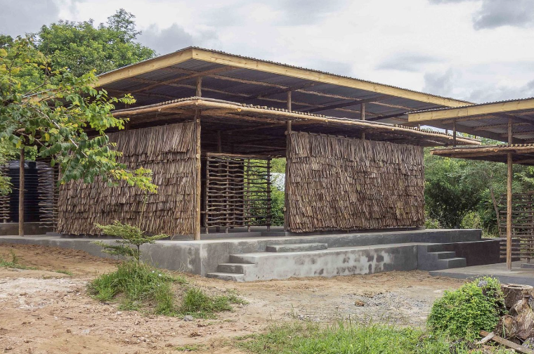
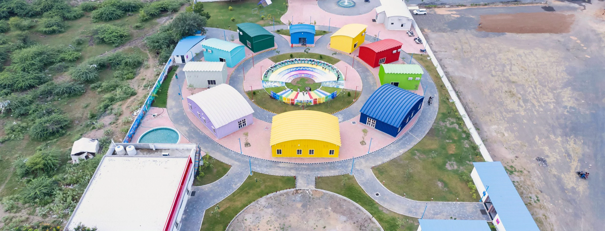

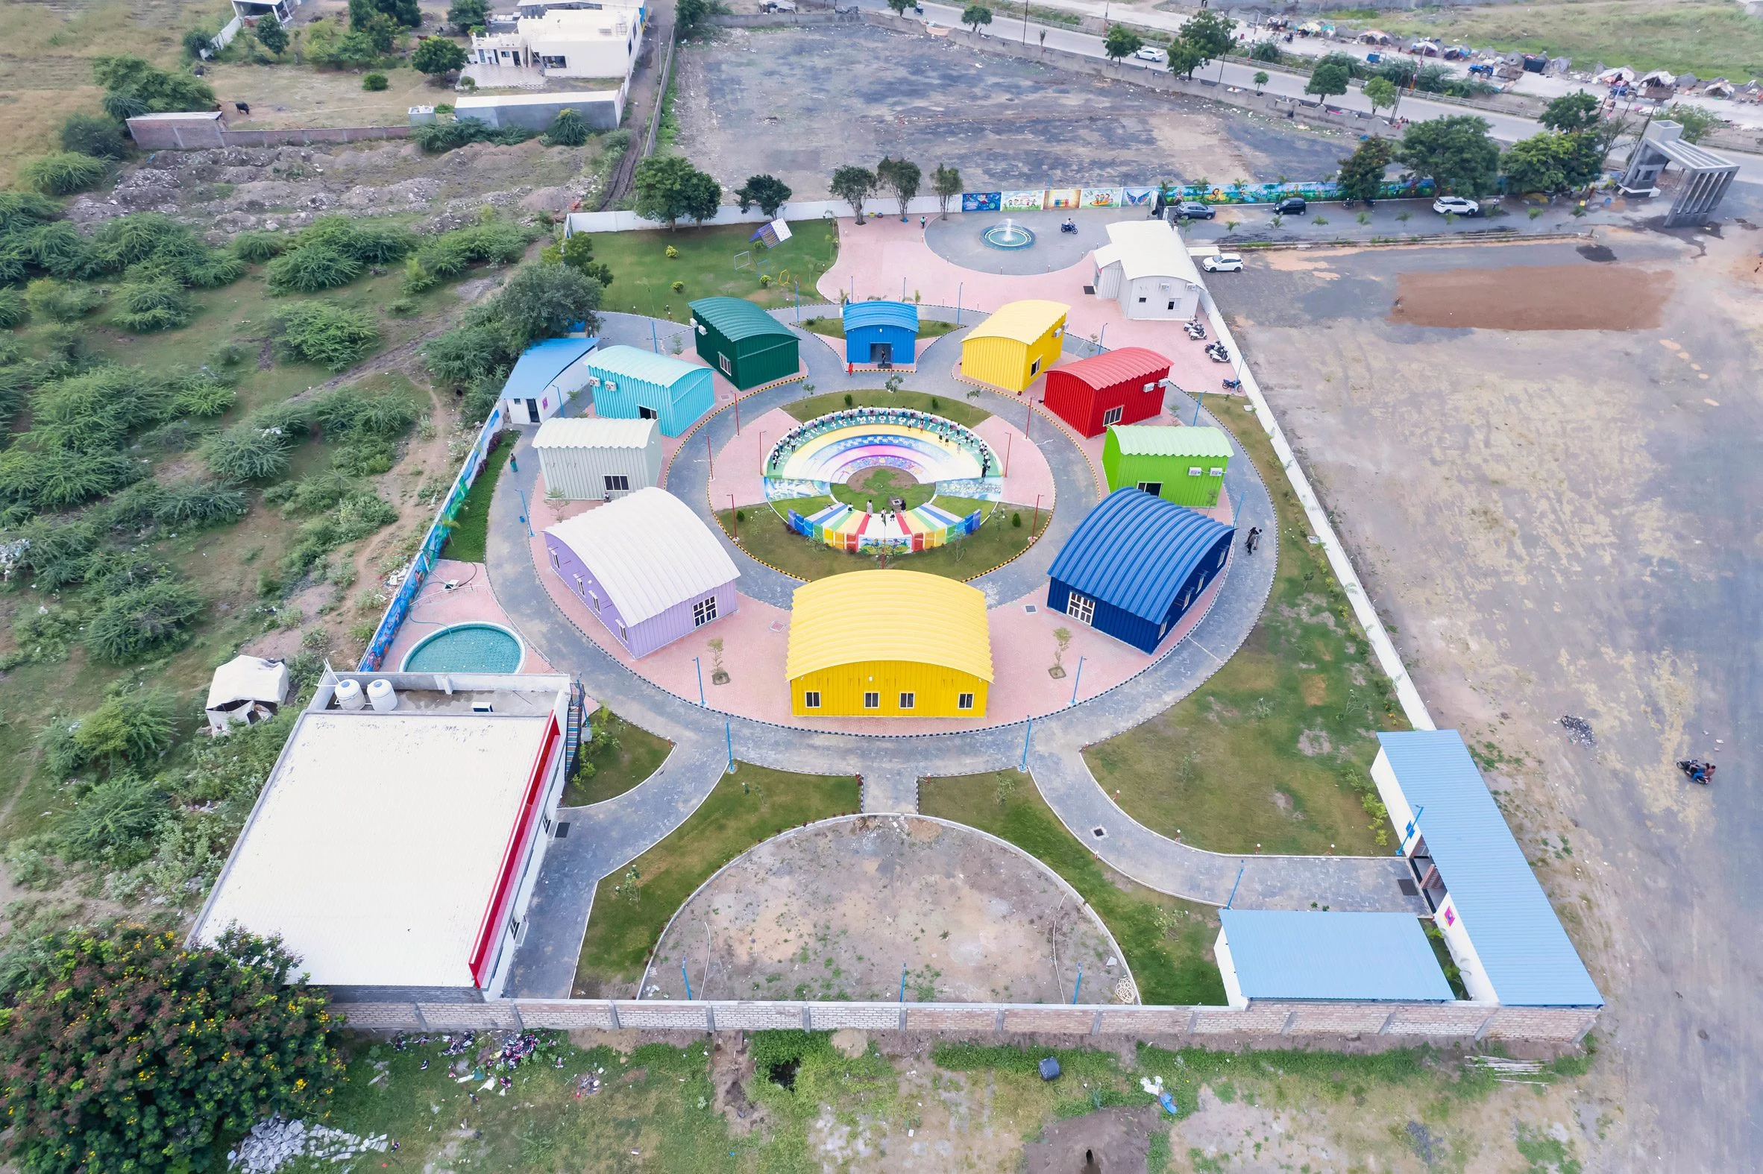
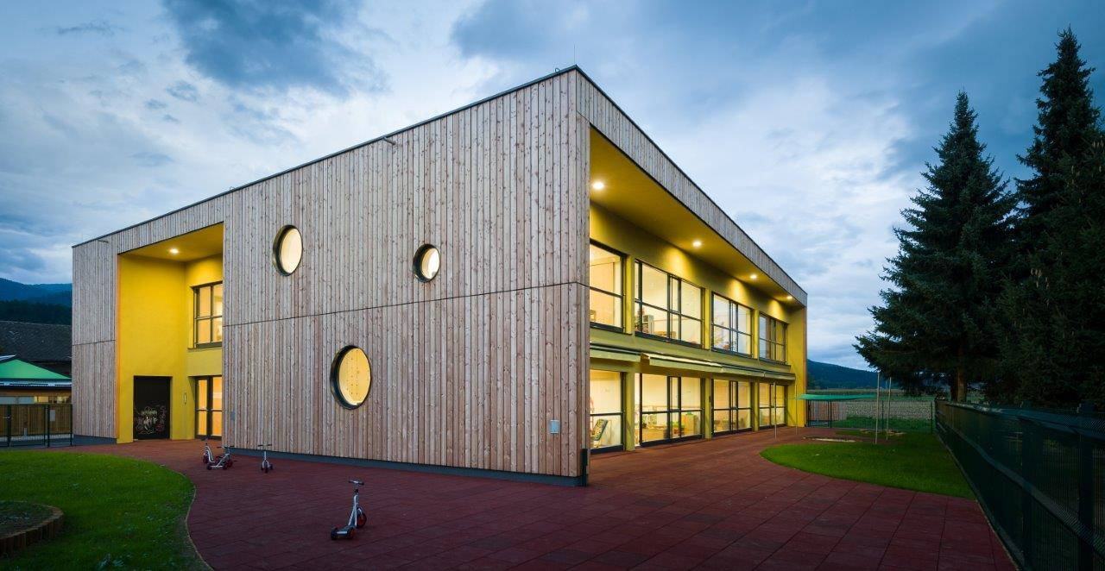
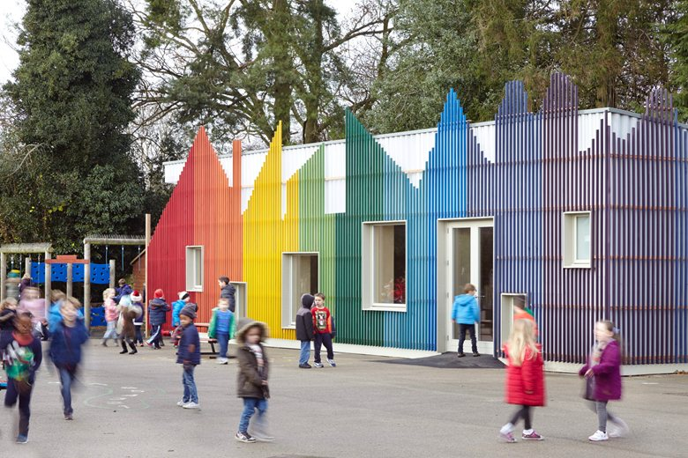
Kindergartens around the world
Eco Moyo Kindergarten, Kenya
Navyug International Pre-School, India
Šmartno Timeshare Kindergarten, Slovenia
Little Hall at Prestwood Infant School, UK
Group 3 : Fang – Eric – Sayed – Olivera

Slide 2
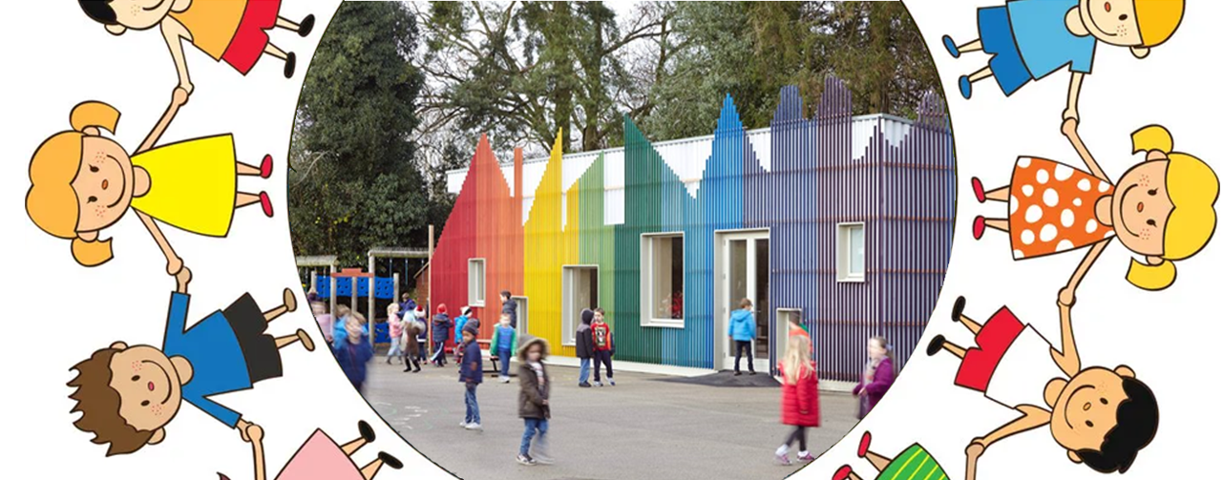
Little Hall at Prestwood Infant school, United Kingdom
Built: 2015
Cost: 158,000 British Pounds
Architects: De Rosee Sa & PMR

Slide 3
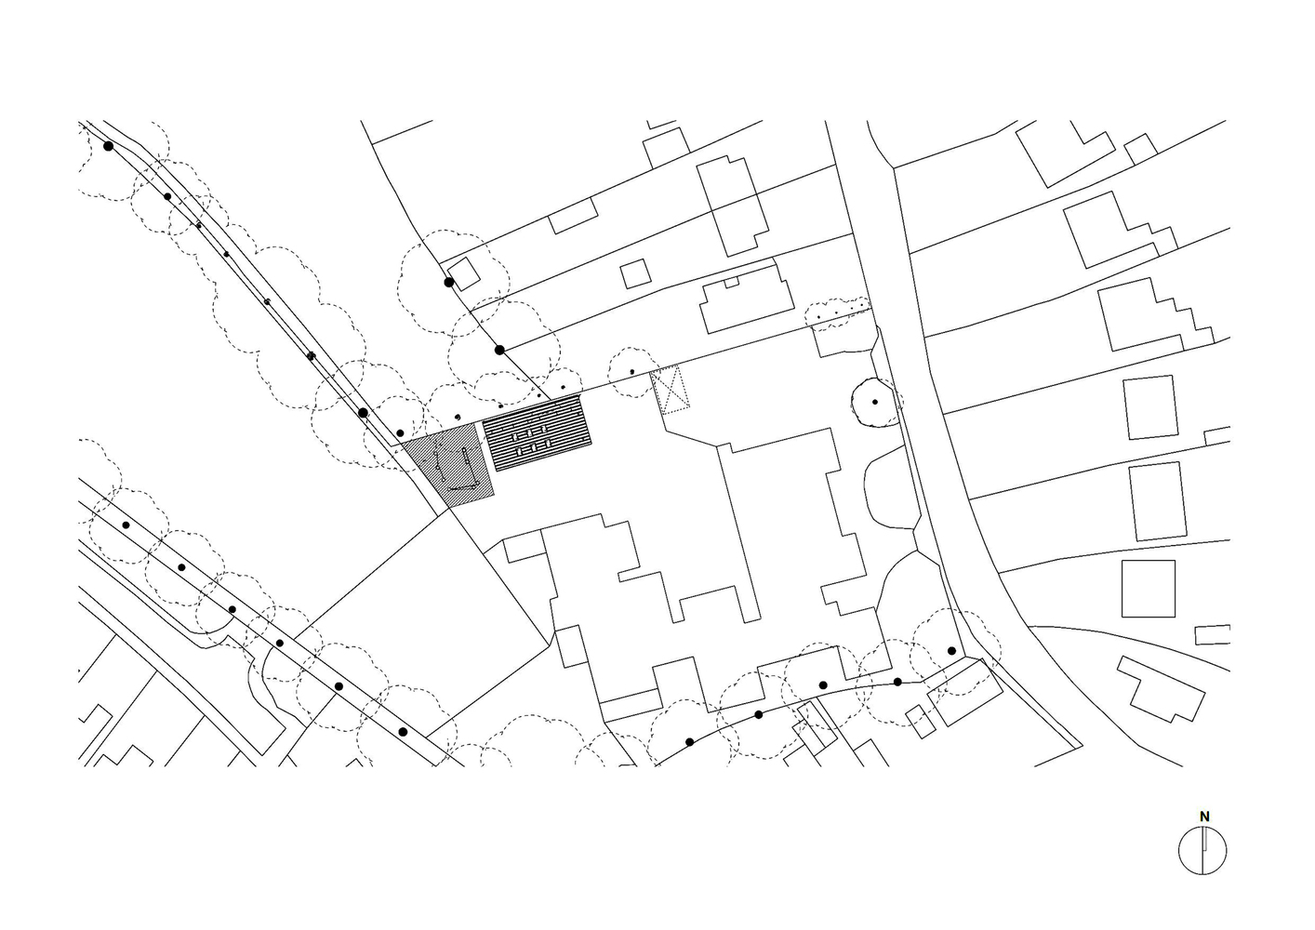

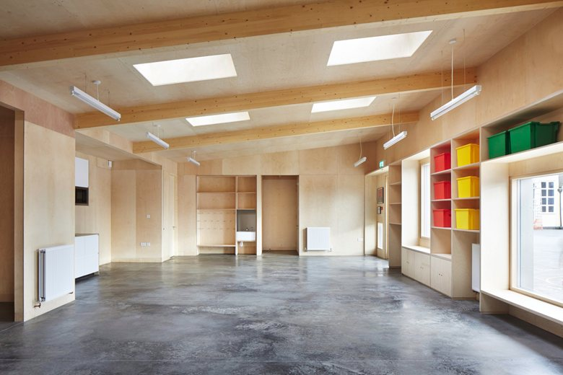
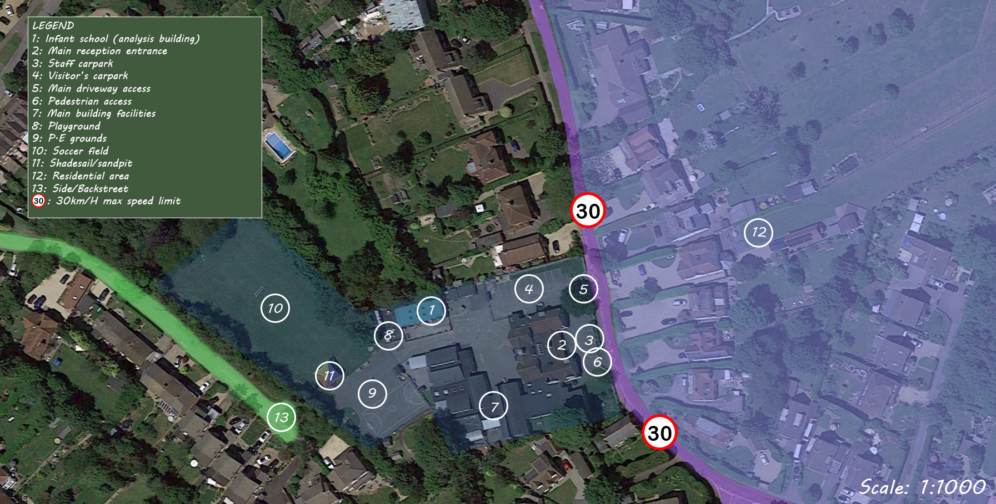
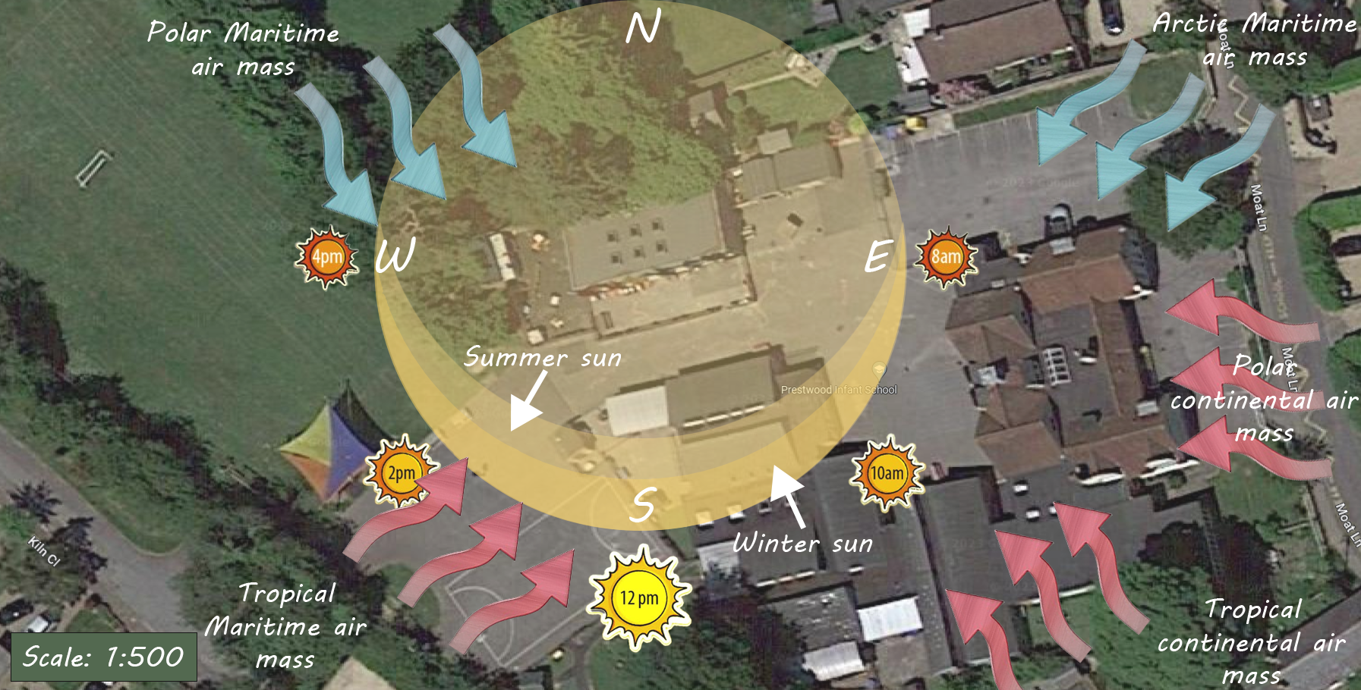
1. Floor plan analysis - Portfolio Stage 1
The infant school for children between 5-7 years is located in Prestwood, UK. Surrounded by trees in a quiet residential area as explained in the site analysis below.
Britain's weather is unique as five air masses battle for supremacy including continental polar, arctic maritime, polar maritime, tropical maritime and tropical continental.

Slide 4
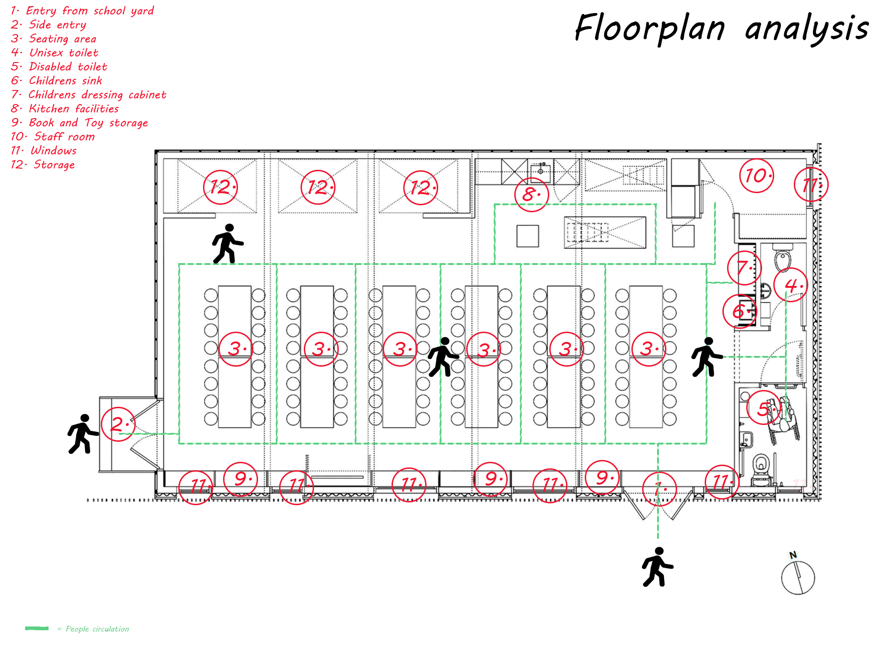
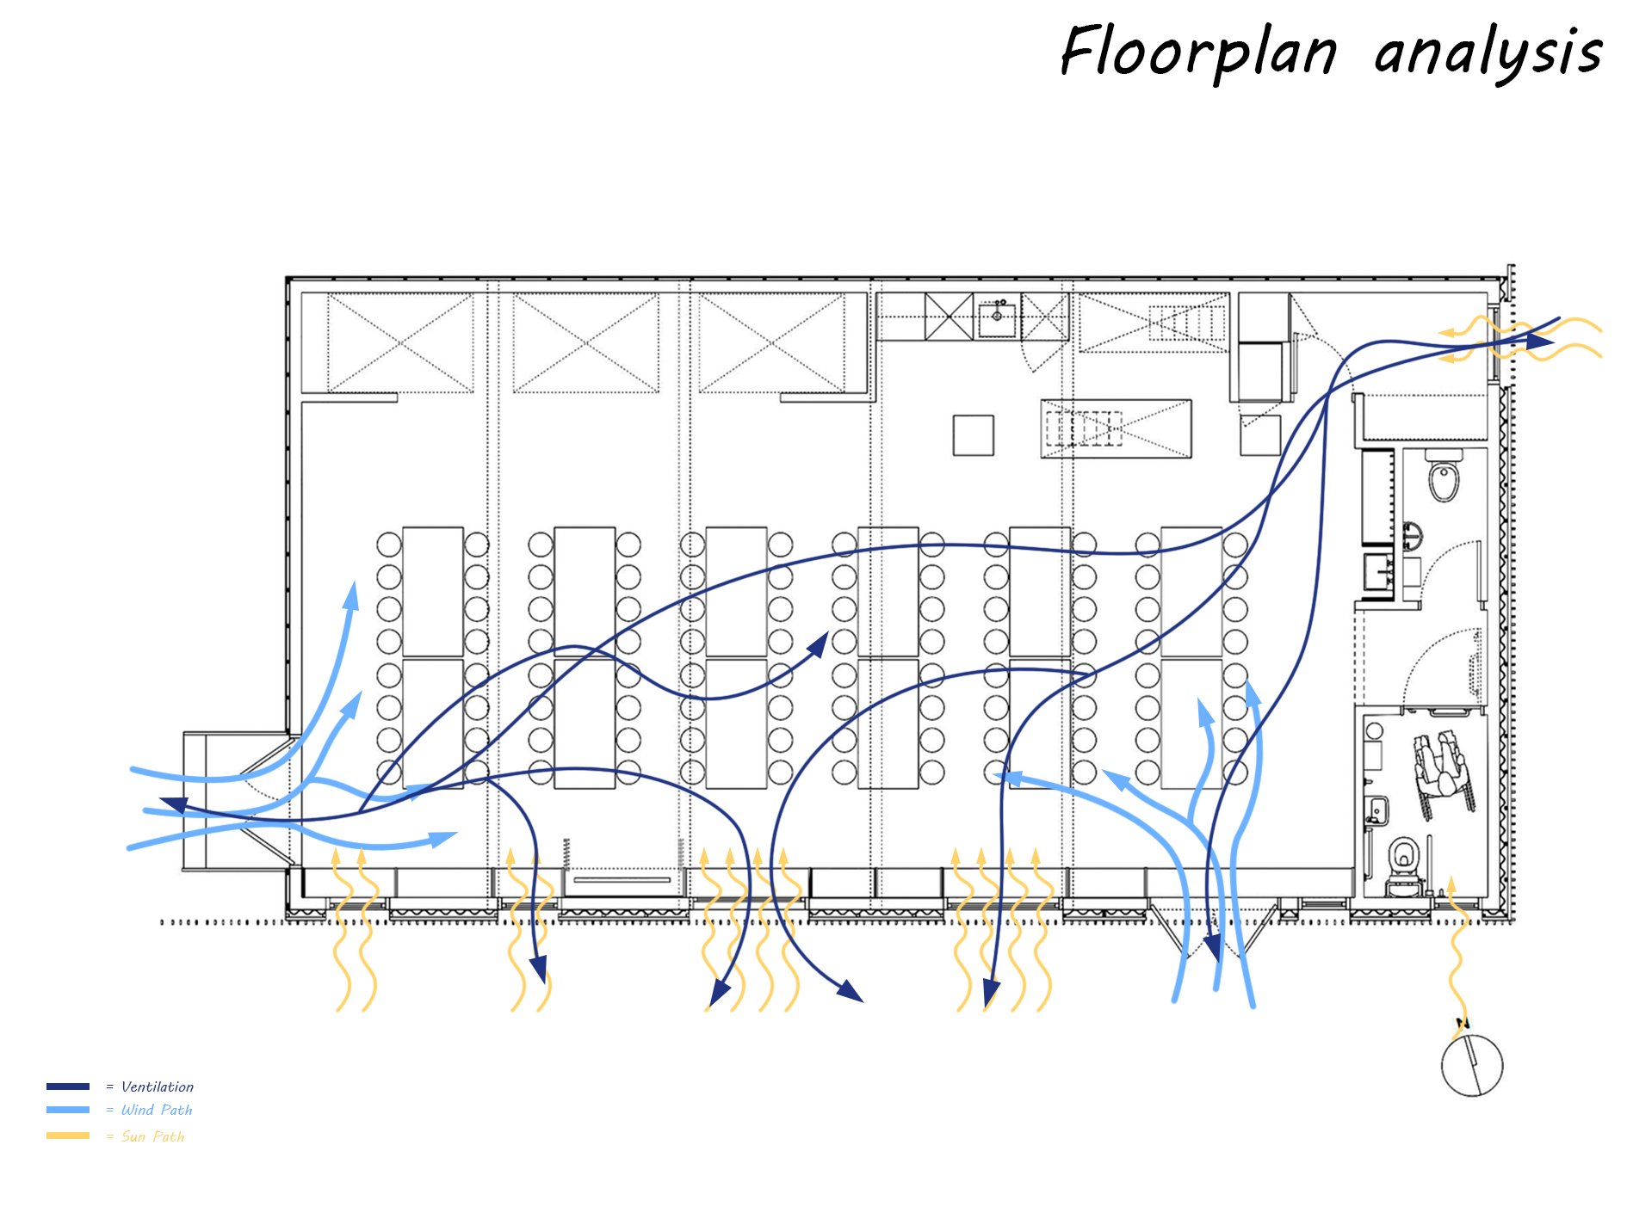
2. Floor plan analysis - Portfolio Stage 2

Slide 5
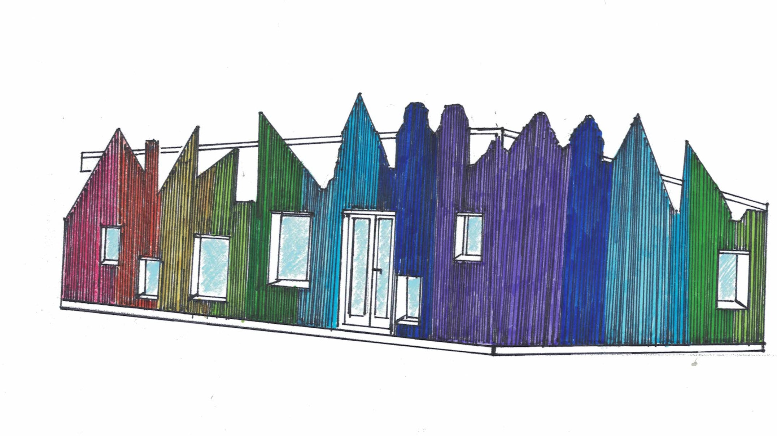
3. Hand sketching Stage 1

Slide 6
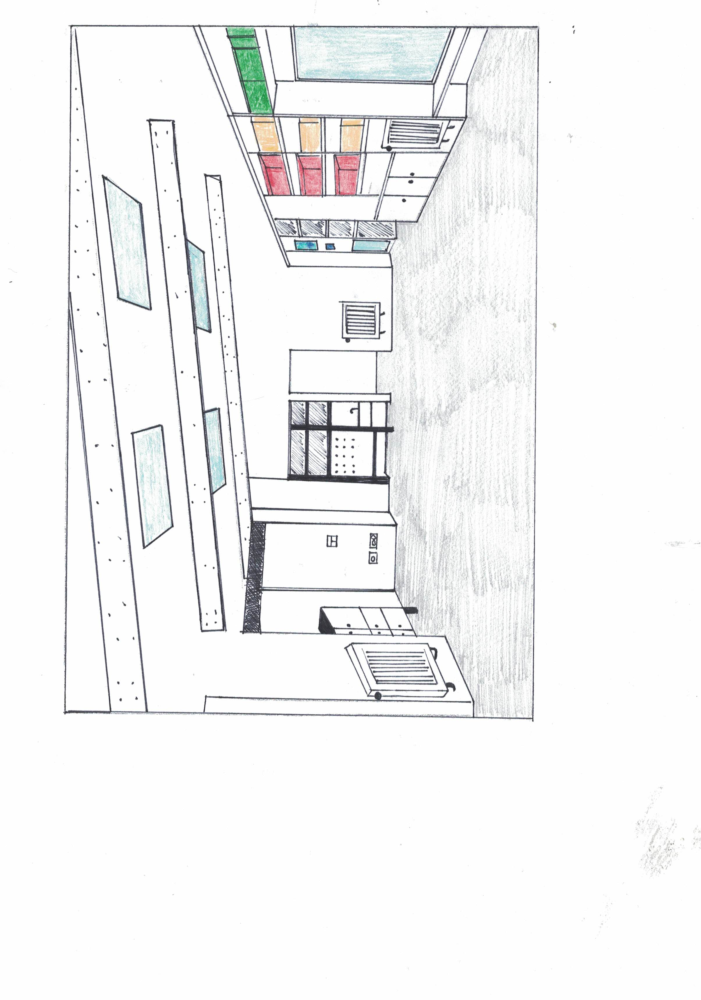
4. Hand sketching Stage 2

Slide 7
5. Notes/plan for physical Model
Have at home tools and utensils:
Scissors, Stanley knife, ruler, pencils, eraser, sharpener, mini saw for timber cutting
Plan:
Using print out drawings to follow shapes and structures on foam board
Kraft board for base of model
Forming model out of form board
Gluing together main structural parts
Gluing match sticks together to form colourful stud walls
Clear PVC sheeting for windows
Silver flute board for metal roof sheeting
Allow extra 1 to 2 days for glue and spray paint to dry
Shopping list:
1 x Gorilla Glue Clear 51 ml $13.60
1 x Foam Board 5mm Thick
(500 x770mm) $16.00
1 x Gorilla Mountain putty white $9.60
2 x Silver Flute Board 30.5x30.5cm $7.00
1 x Kraft board 30.5x30.5cm $4.25
2 x Skinny Sticks 148x5mm, 80pk $5.00
1x Wooden match sticks coloured $2.98
Time management | Date | Status
Materials | 08/06/2023 | Finished
Started drawing on foam board | 09/06/2023 | Finished
Cutting out shapes | 10/06/2023 | Finished
Starting to glue together and leave to set

Slide 8
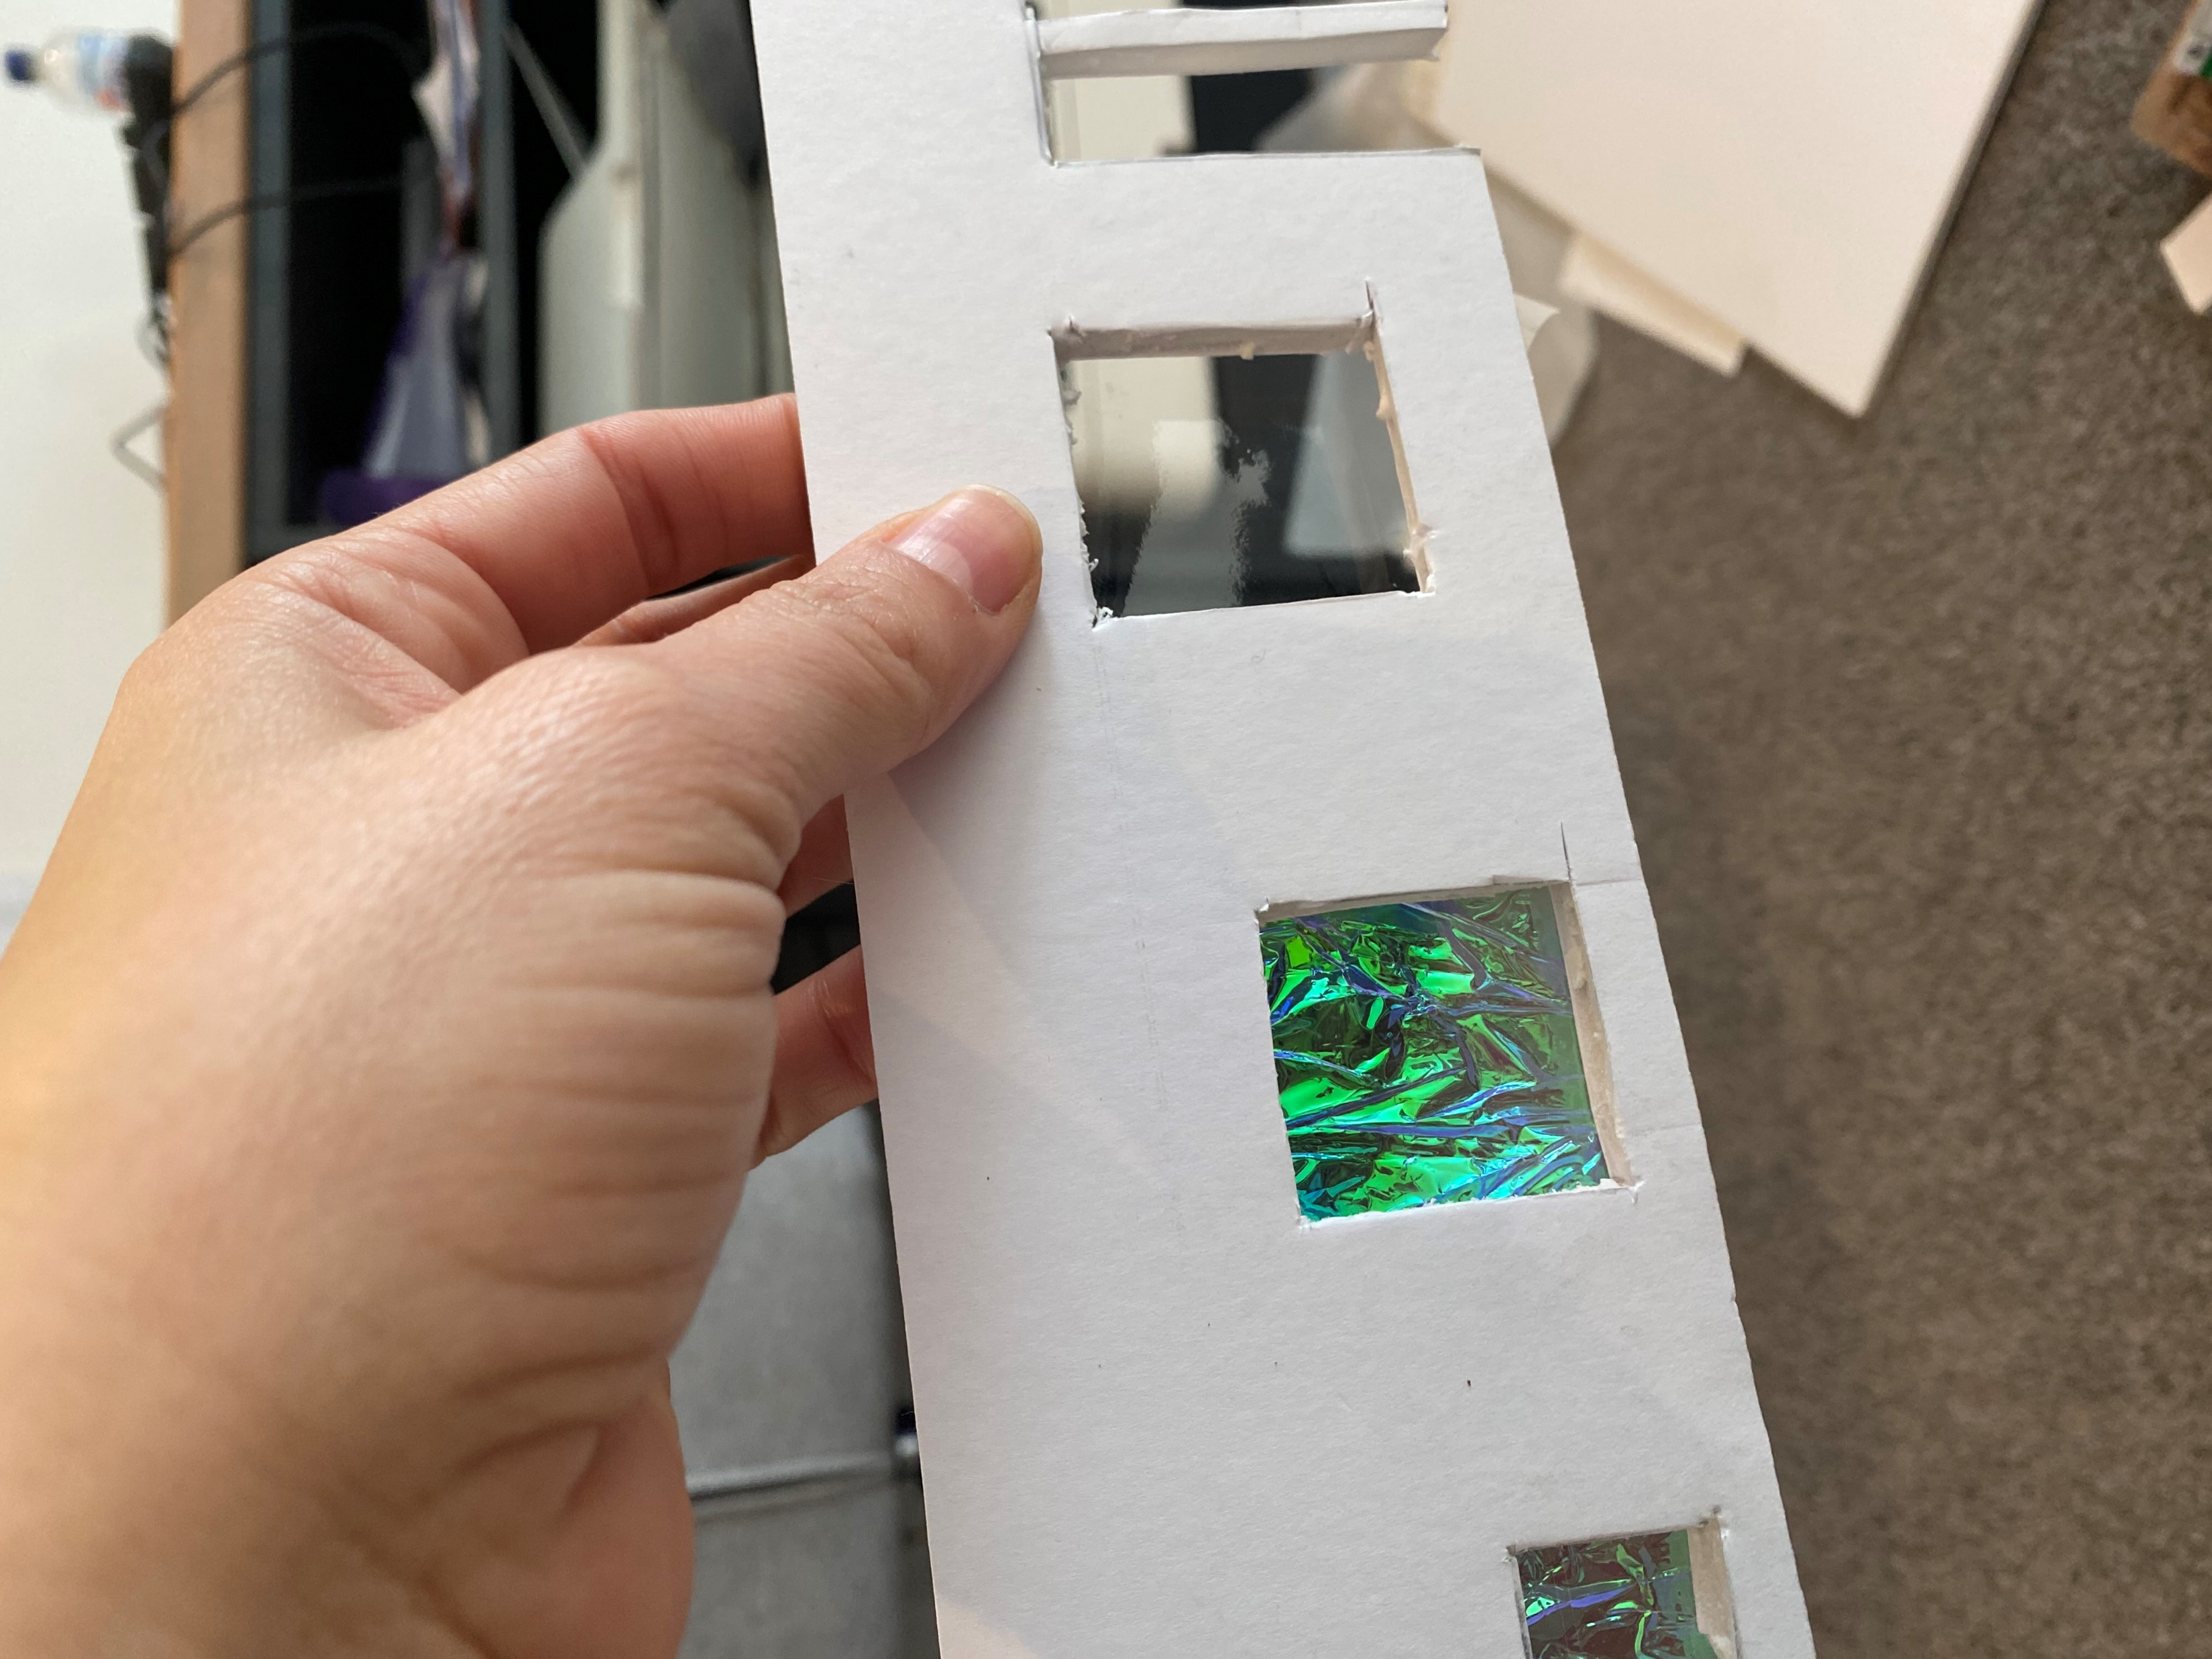
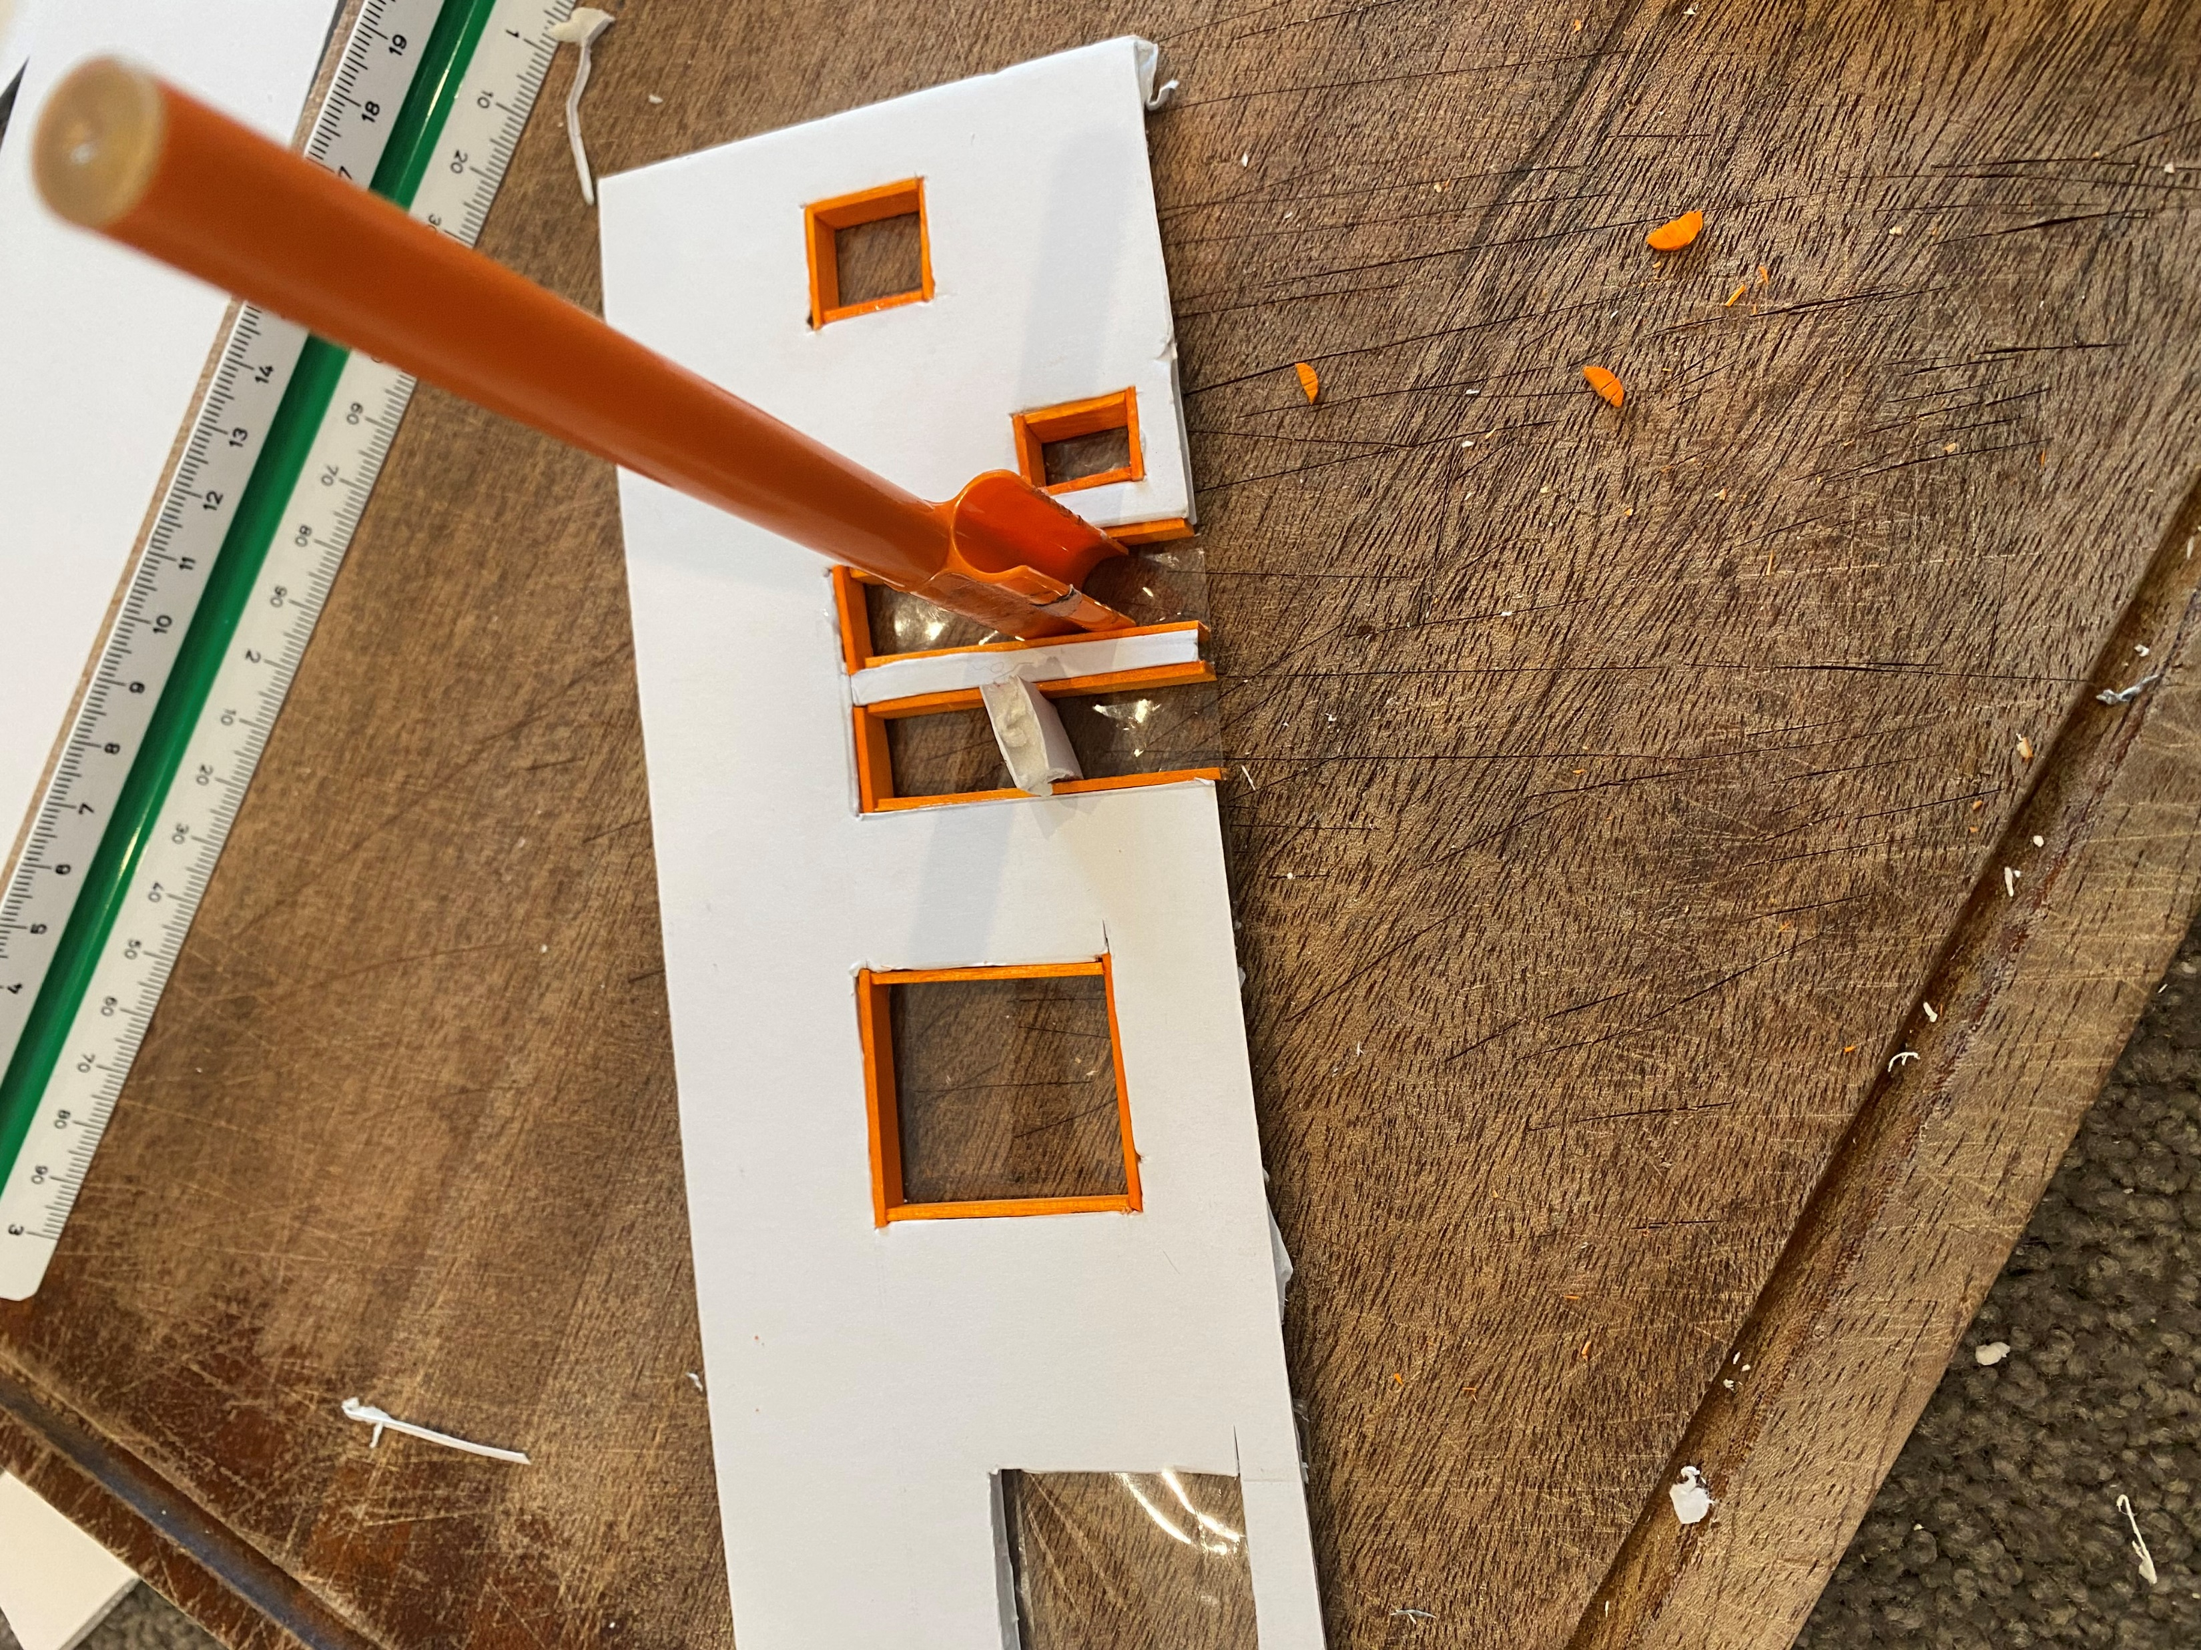
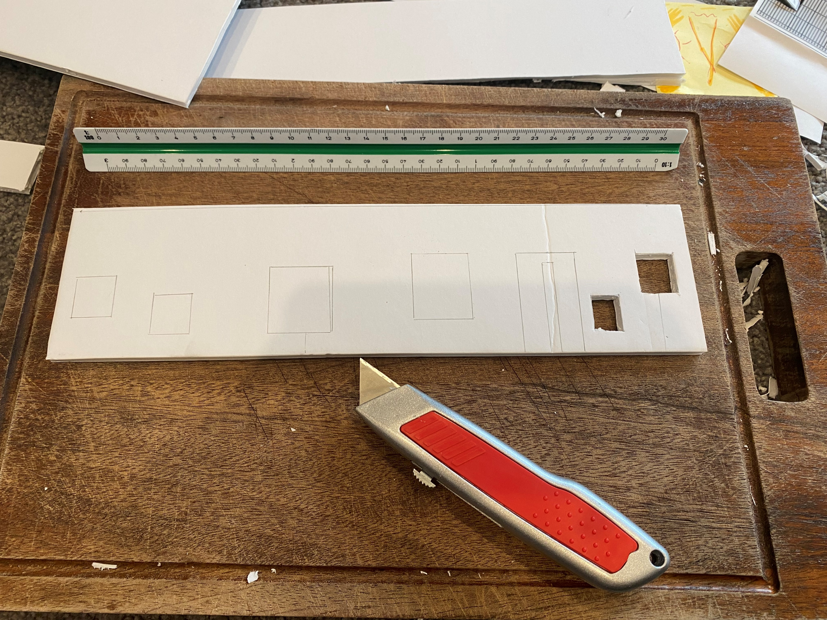
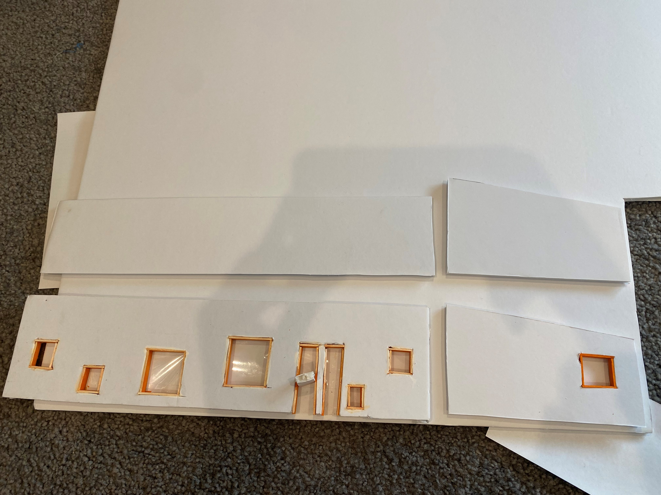
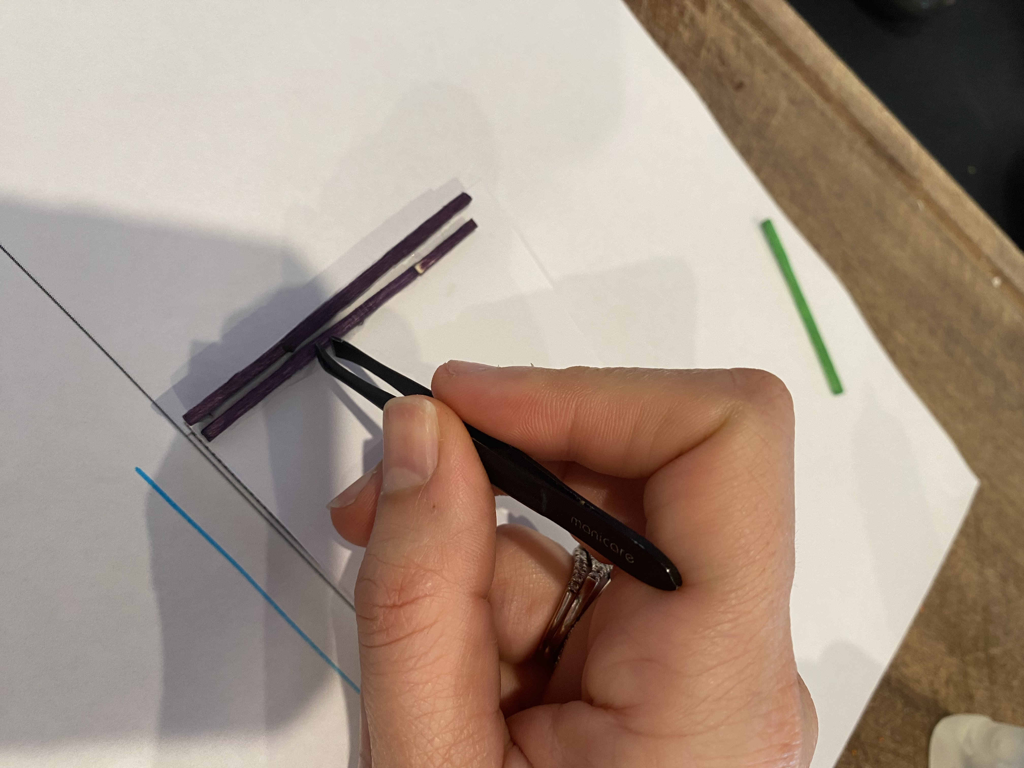
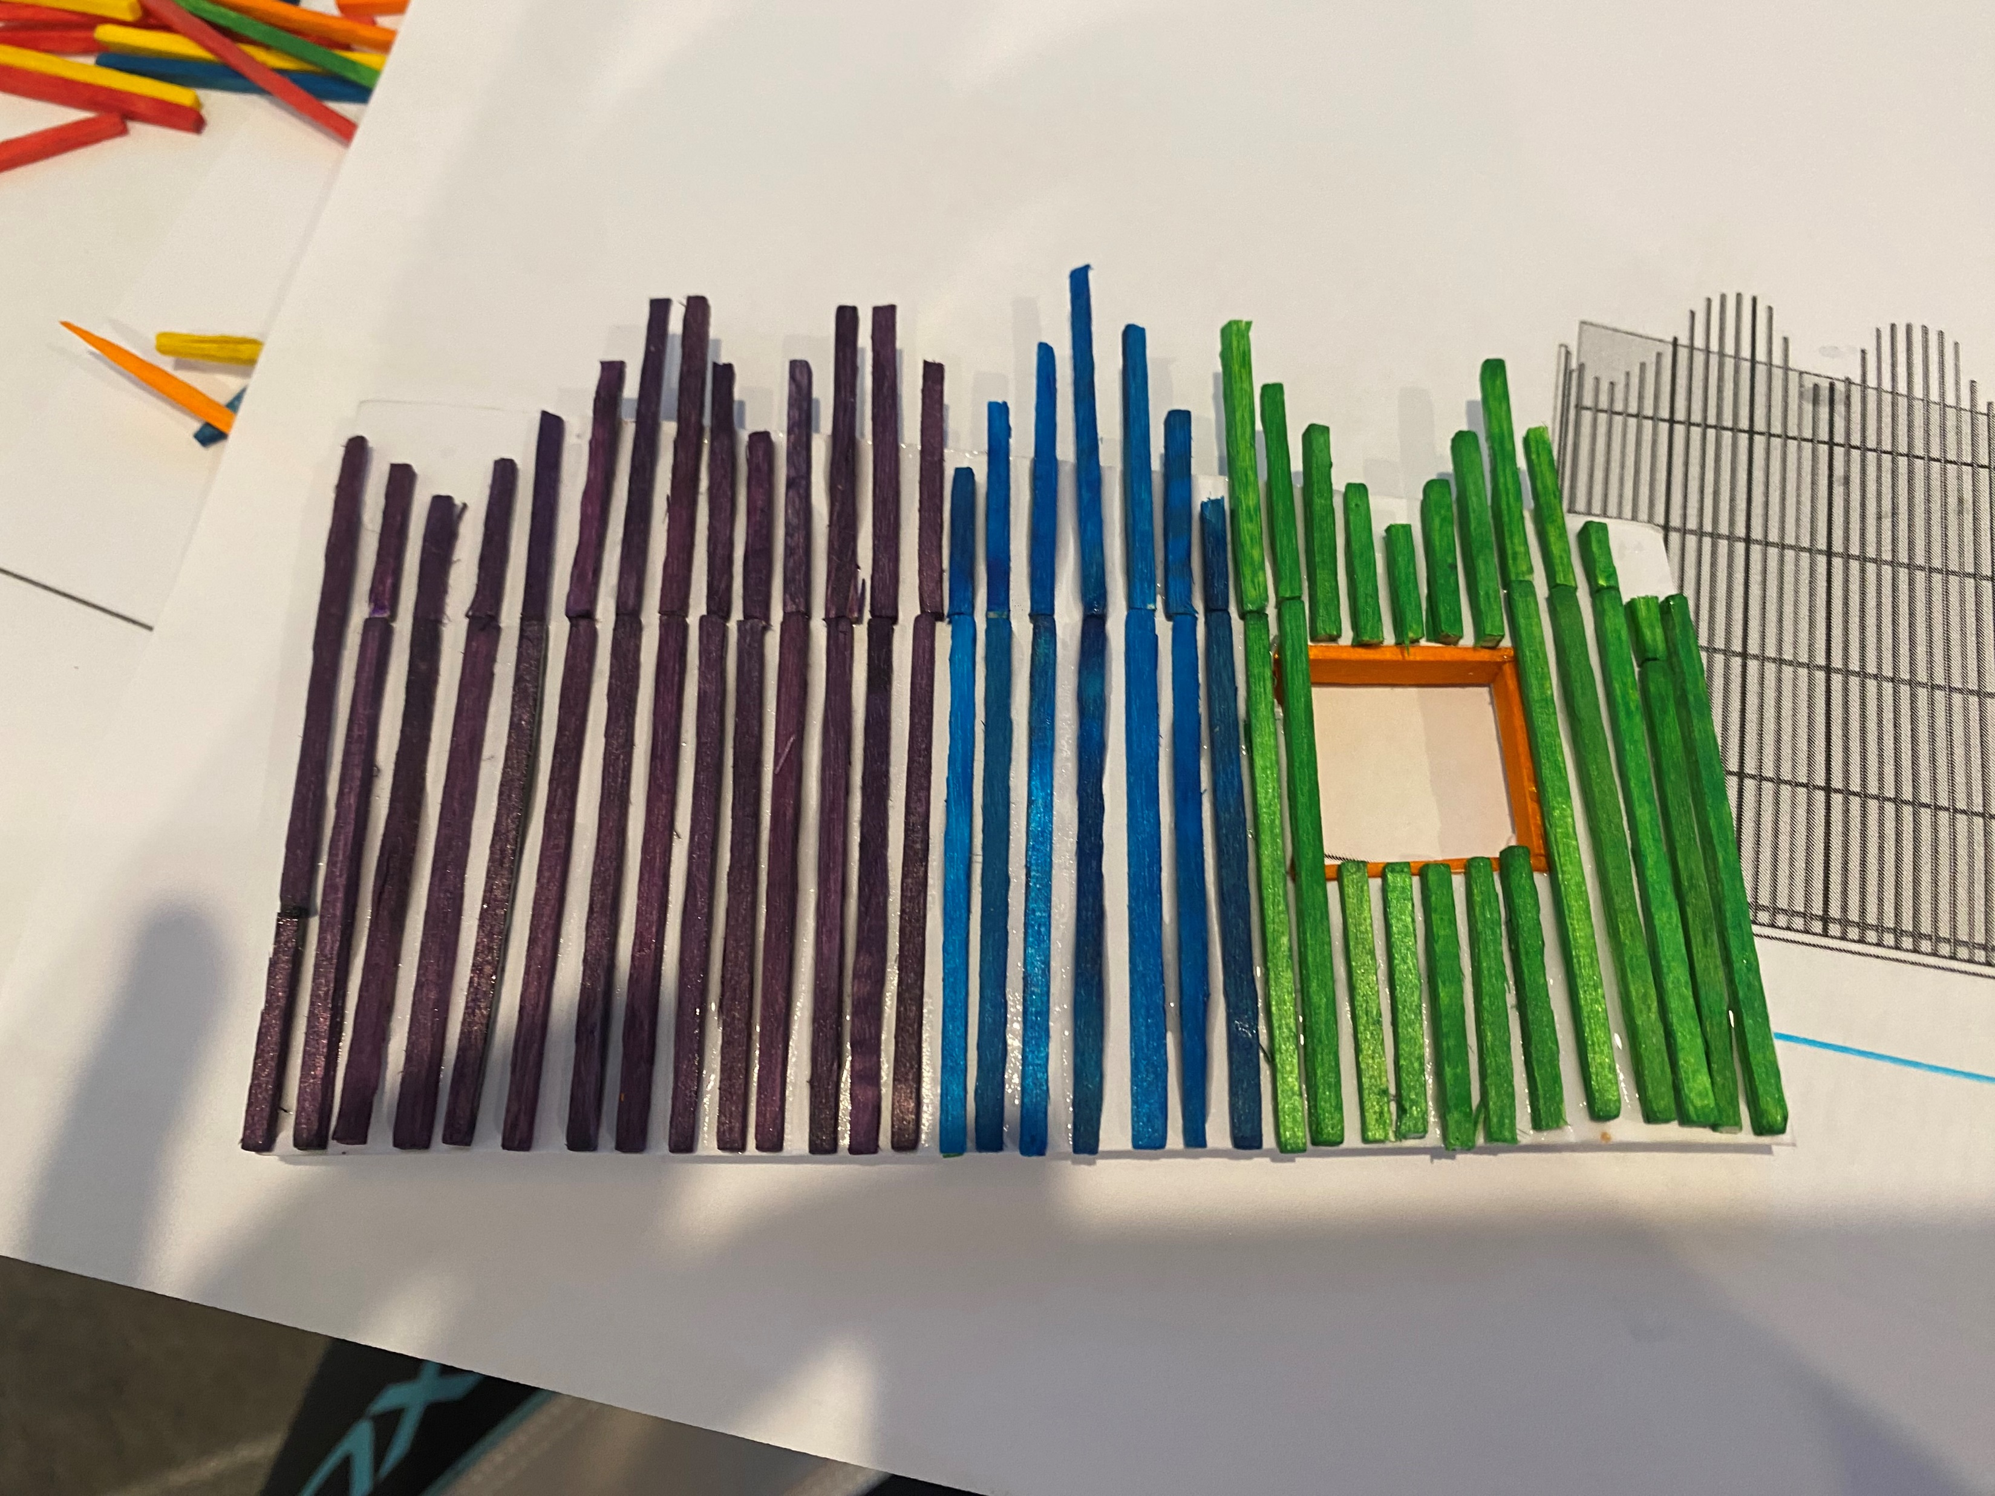
6. Physical Model progress
Cutting out shapes
Comparing clear foil to
translucent foil for windows
Building window frames
and applying glue
Finalising structural shapes
Applying timber sticks
with tweezers
Following colour pattern of sticks

Slide 9
7. Group topic theme “Kindergartens all over the world”
Group 3, (Eric, Sayed, Fang and myself) decided to look at Kindergarten facilities around the world, because children all around the world deserve a save environment where they can play, learn and socialize. Kindergartens have all the same main target, to keep children safe and make them feel happy and comfortable. We selected different models around the world and everyone picked a different cultural background as well. It will be interesting to see some similarities but also differences in building design, structural design and safety for all case studies. We decided to follow same font style for the group project which will be Comic Sans Ms and our poster will include a centre picture which I have included here.
I picked the case study Little Hall in Preston, UK. The simplicity of the building but also colorful and playful design caught my interest. The famous children’s author Roald Dahl was the inspiration for the building, which was built in 2015.

Slide 10
8. Our group theme style:
Topic: Kindergarten all over the world
Logo: Picture 1
Font style : Comic Sans Ms
Font size: Title 28, Text 15
Document type: Powerpoint
Colour code: White backround, orange footing
Layout: Landscape format
Photosize: 10cm x 15cm
Picture 1

